Slide 1


ESCAPE TO THE CASTLE
Group 28: Chelsea De Marseilla, Adrian Loenan, James Ballantine, Matthew Stewart

Slide 2
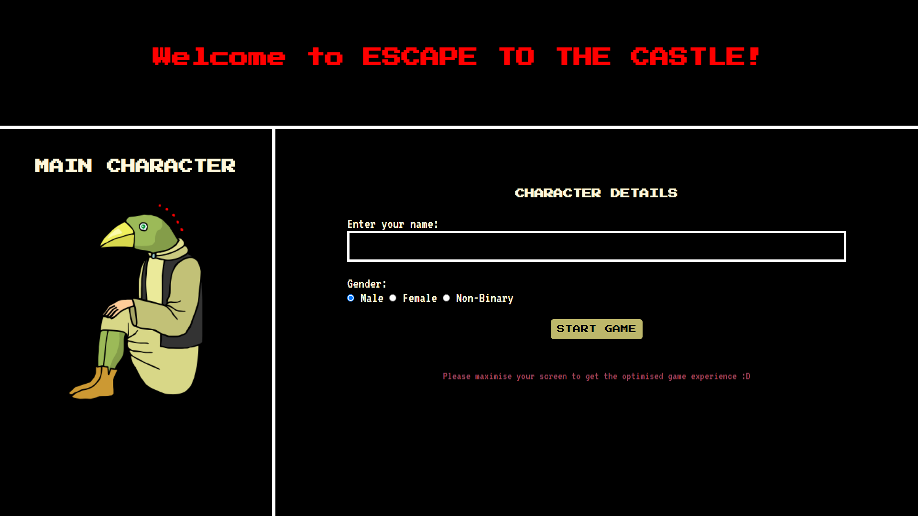
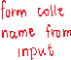
Collection of data through form input

Slide 3
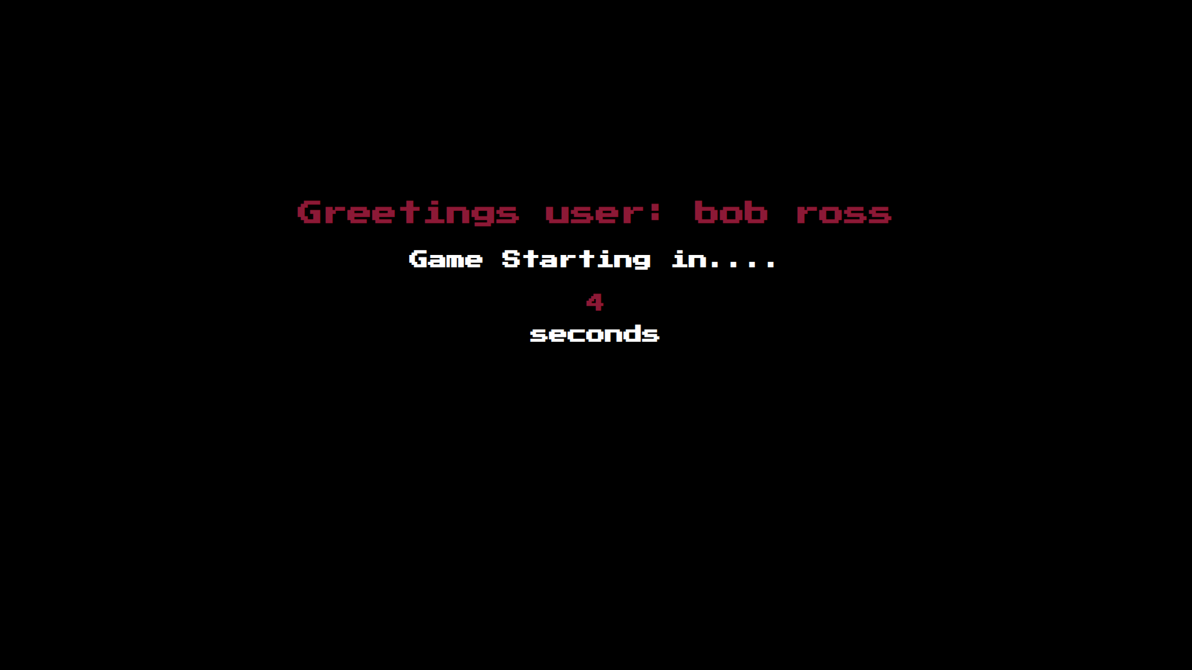


Game personalisation: sample 1

Slide 4
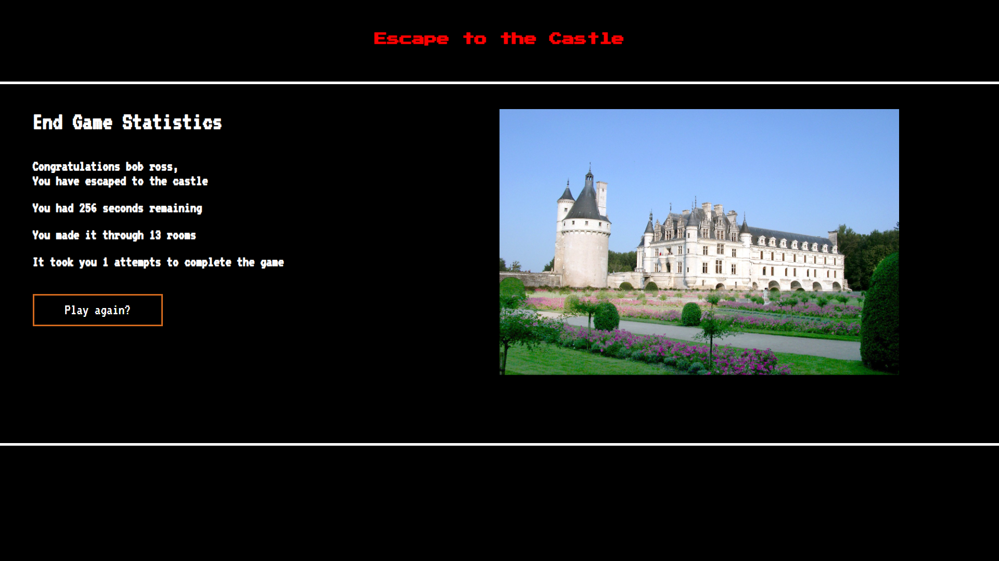

Game personalisation: sample 2

Slide 5
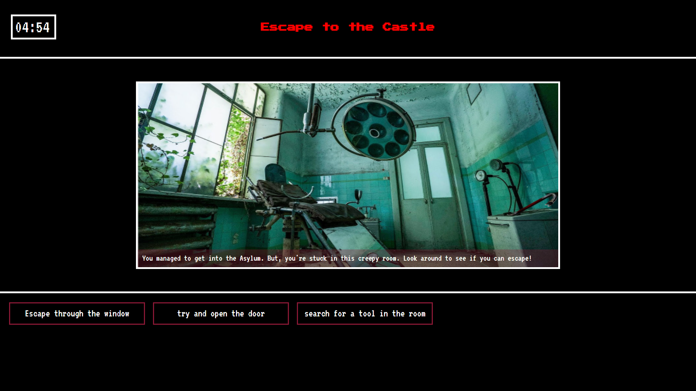
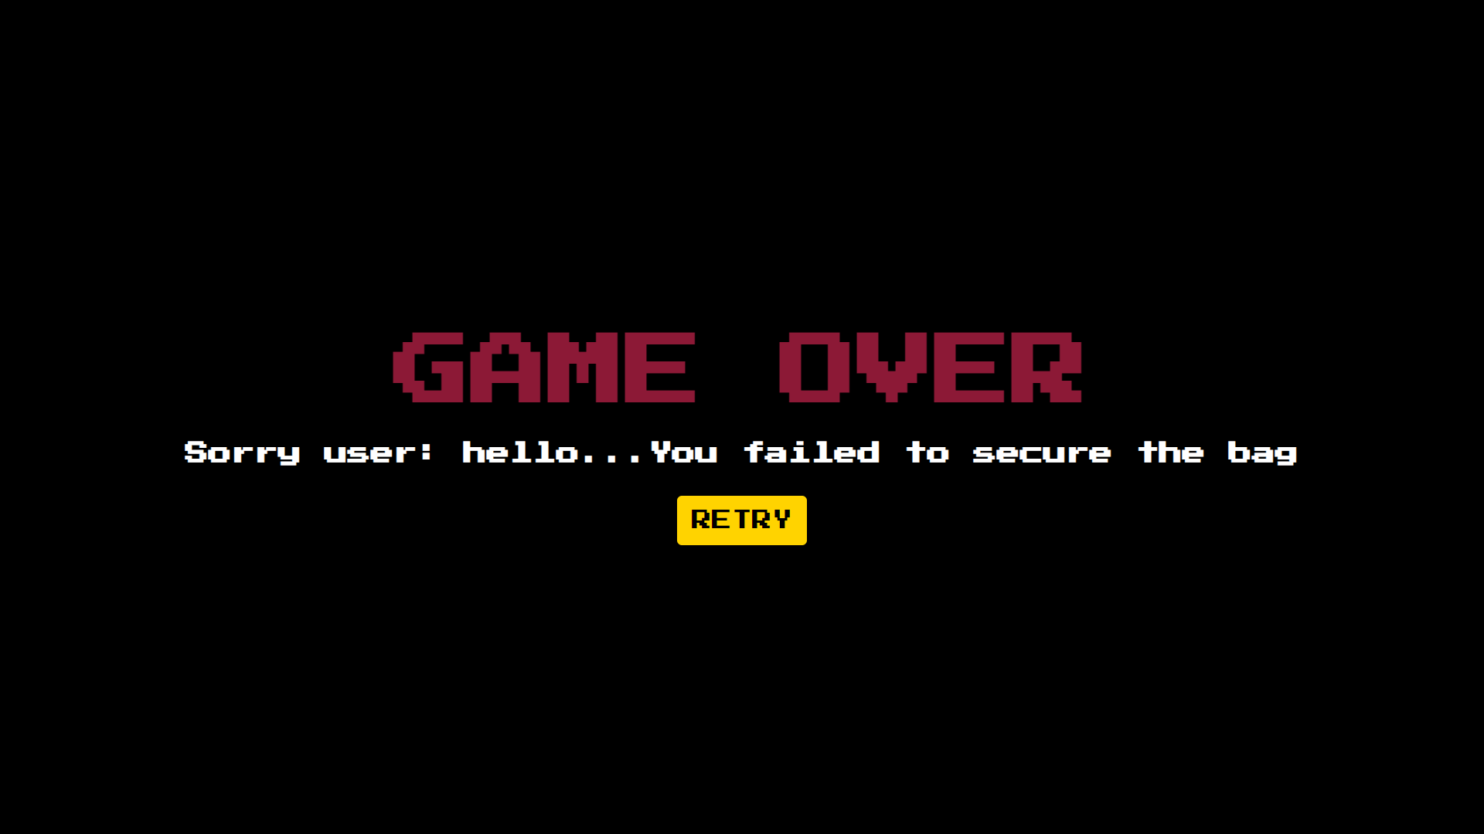

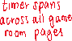
Javascript timed events
Timer set to countdown from initial time of 5 minutes
Player redirected here if time limit exceeded

Slide 6
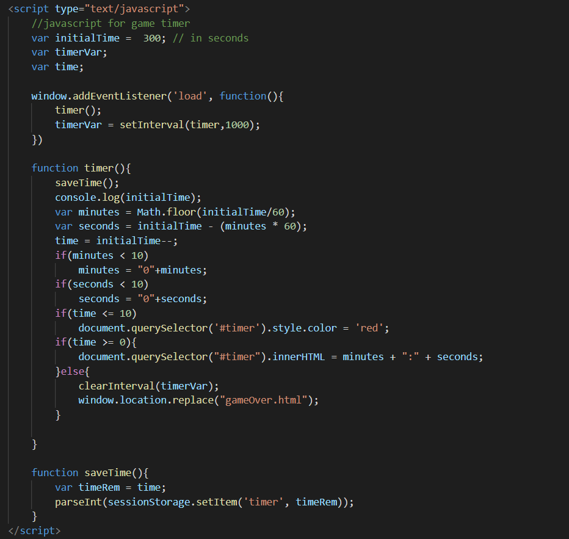
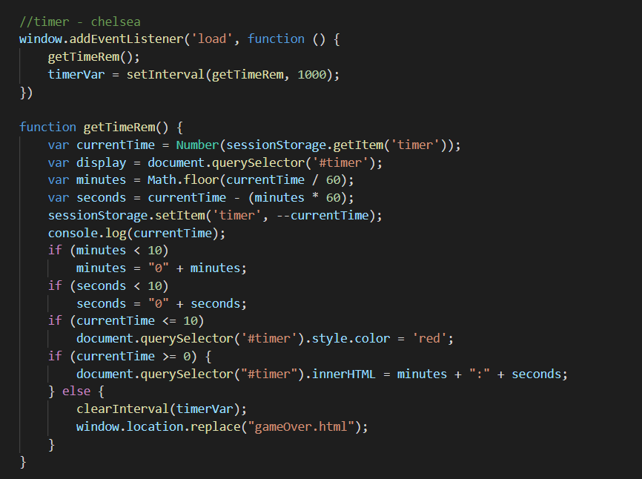
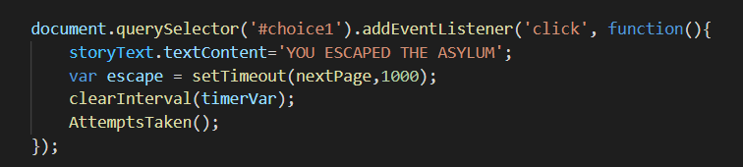
The code behind the timed events
The code below calls the saved session storage key and obtains the current time from the previous page. It then uses that value to continue the countdown without resetting the timer back to 5 minutes.
In the last room, the player is presented with an ESCAPE button to leave the asylum. I’ve set it to pause the timer and save the time remaining. This will then be displayed in the statistics page
The code above sets the timer’s initial time to 300 seconds which will be converted by a series of equations to display as in minutes + seconds form. Session storage is then used to save the current time on that page to pass along the following page
Both functions are set to redirect to the Game Over screen once the time limit exceeds 5 minutes

Slide 7
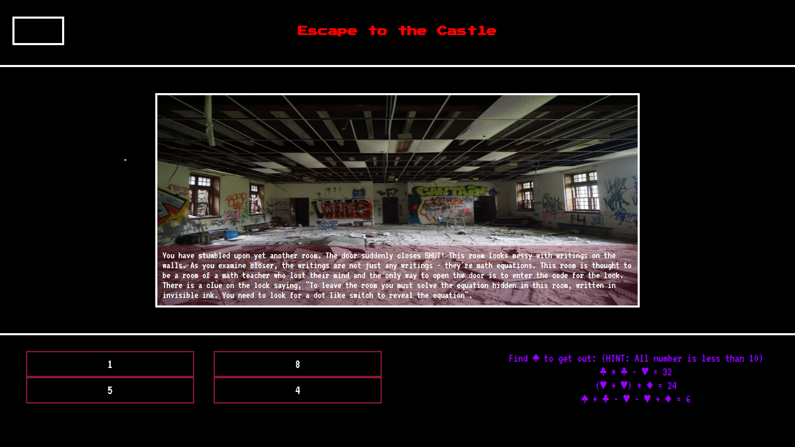
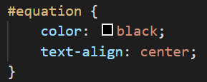
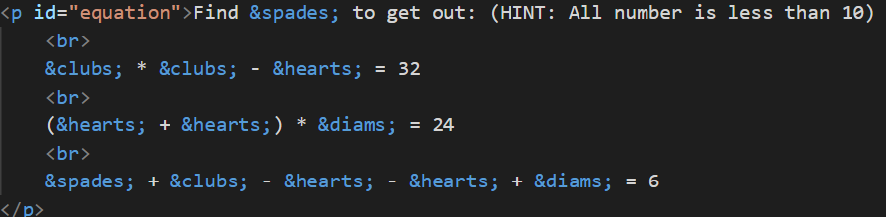
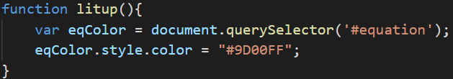
Operation of text adventure elements: button select
Paragraph with id “#equation” is set to font colour: black initially
Pressing the correct input button then redirects the player to the next room
The output of the room containing the litup button and equation. The green arrow is pointing at the button and the magenta arrow points to the equation.
Litup function that is executed when the litup button is clicked.
Using the button element to create a button with and id, litup and return the litup() function when clicked.

Slide 8
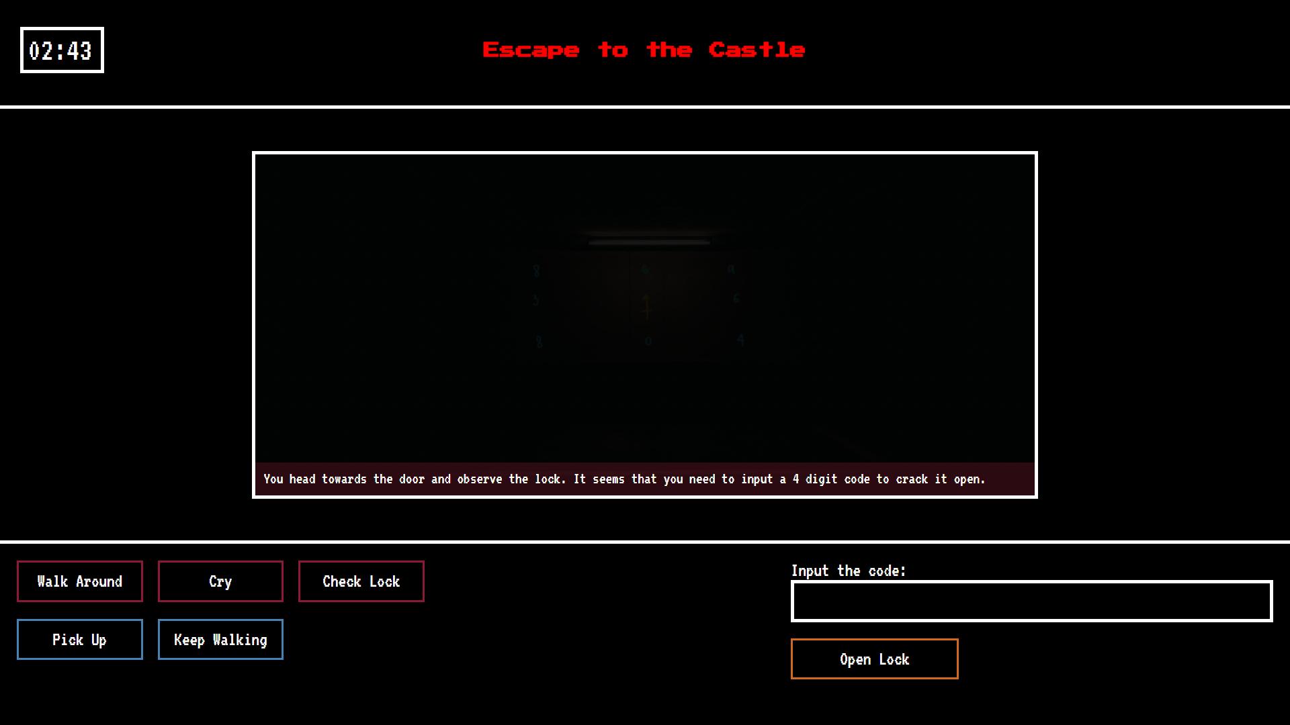
Operation of text adventure elements: text input + button select
Upon submission, the user will either be redirected to the next room or shown an error message as well as styling changes to notify that their code is incorrect
Players are expected to play around with the buttons to display certain features (hints)
The player is required to use the hints provided by the game to input a code within this text input box

Slide 9
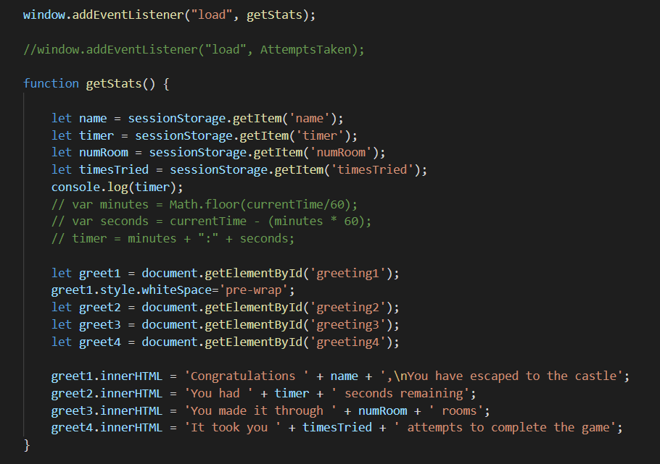
statistics
The code below is used to get all data saved in the session storage keys
This is the statistics page, it shows the name of the user, time remaining, number of rooms entered and attempts at the game. This is achieved by using session storage to store the relevant data throughout the game so it can then be output in the statistic page

Slide 10
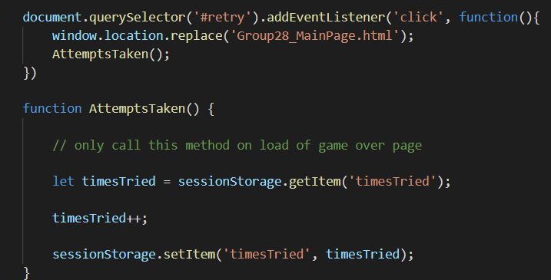
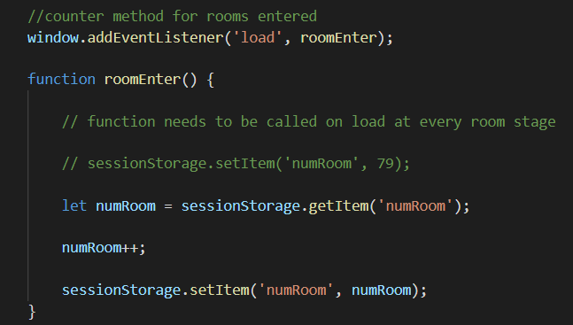
Collecting data for stats
The retry button is selected by query selector and calls the AttemptsTaken() function to update the counter when clicked on. The count is then saved
On load, each game room (within the asylum) updates the counter by 1. This function is used to display the number of rooms the player has entered

Slide 11
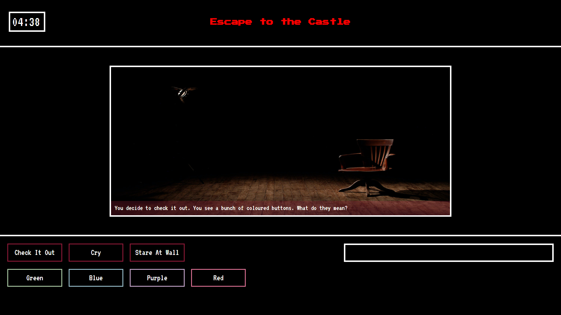
Accessibility features
In the colour room, I have taken into consideration the possibility of players being colour blind. For each coloured button, I have specified the names of each colour so that the players would not have trouble differentiating colours.

Slide 12
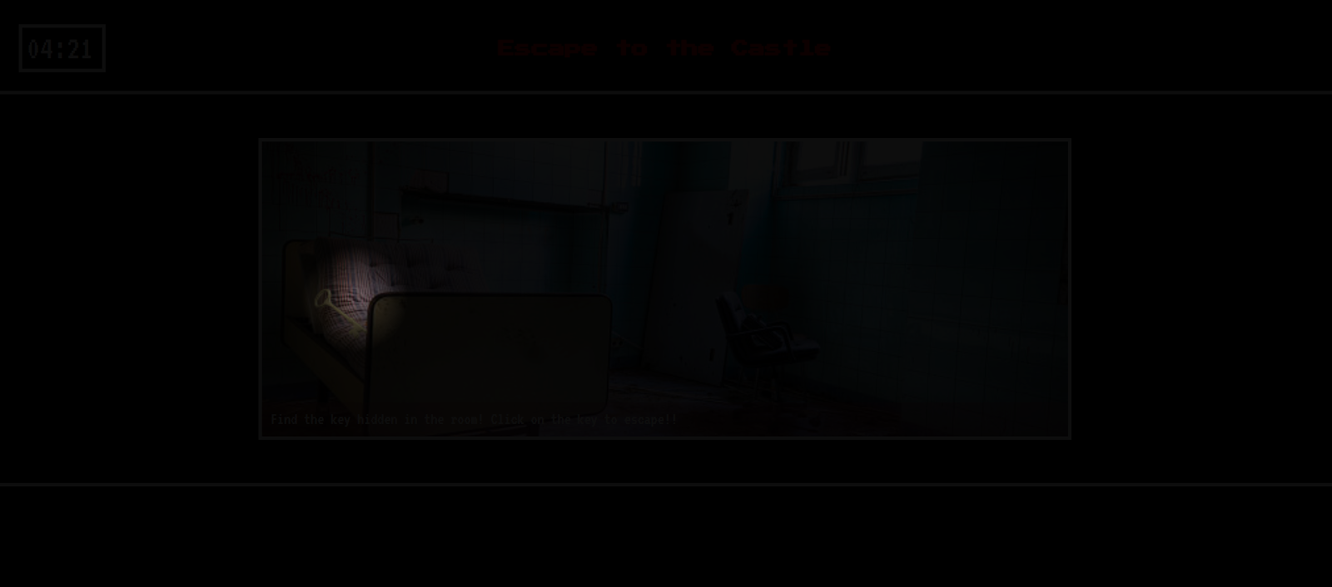
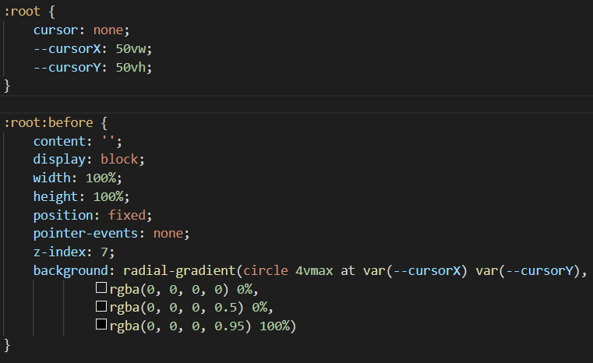
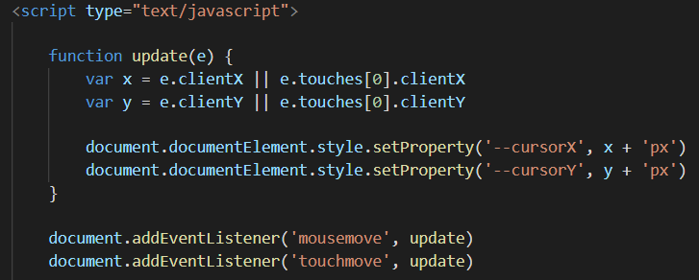
Top features of the game: torch effect
Torch effect
The torch effect is one of the top features of the game. It allows the user to interact with the game by moving the cursor to try to find the key.
This torch room improves the technical complexity and user experience of the game
The function within JavaScript is created which updates the position of the flashlight with the mouse and allows for full range of movement around the screen.
Within the code Z-index is used to ensure that the flashlight activates at the correct layer (on the room image). The size of the circle is set to 4 to make finding the key challenging for the user but also possible.

Slide 13
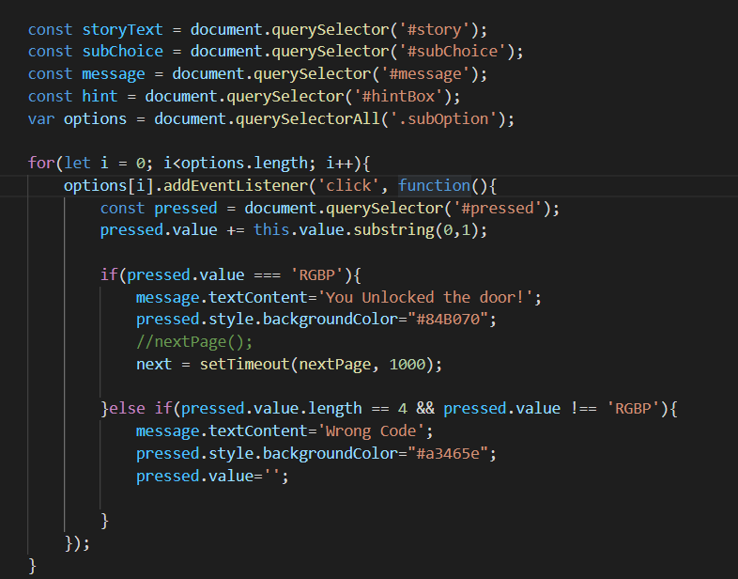
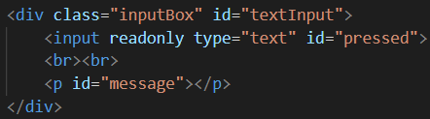
Top features of the game: colour room
A node list is created to select all of the coloured buttons. This function is designed so that when the button (within the node list) is pressed, the first letter adds up to the input box’s (#pressed)
value
When pressed, the coloured buttons are set to display the first letter of their name in the input box. Pressing the buttons builds up to form the final code.
Input box is set to read only so it won’t accept any other input aside from the buttons

Slide 14
Image references
https://pixabay.com/images/id-3430180/ (Outside Asylum image)
https://www.freeimages.com/photo/loira-castle-series-01-1227652 (Castle image)
https://www.istockphoto.com/es/search/2/image?phrase=hole%20in%20wall (hole in wall)
https://i.ytimg.com/vi/ZWOHGwV2Ezc/maxresdefault.jpg (Asylum image)
https://unsplash.com/photos/JUbjYFvCv00 (Exit door image)
https://www.clipartmax.com/middle/m2H7N4A0H7K9d3d3_art-common-good-clipart/ (main character png)
Photo by Marcelo Jaboo from Pexels: https://www.pexels.com/photo/brown-wooden-armchair-on-brown-wooden-floor-696407/ (colour room)
Photo by Oleg Magni from Pexels: https://www.pexels.com/photo/lighted-fluorescent-tube-1040499/ (the torch room)
https://unsplash.com/photos/xo8jJxdI_PA (math room - adrianroom1)
Photo by Jimmy Chan from Pexels (morse code room - adrianroom2)
https://www.istockphoto.com/photo/ruined-bedroom-hdr-gm176847894-17945860 (james asylum room)
Copyright Conditions have been satisfied

Slide 15


THANK YOU

